Slide 1
ETL extract, transform & load
TUYET NGUYEN
John read
Fabio braga

Slide 2

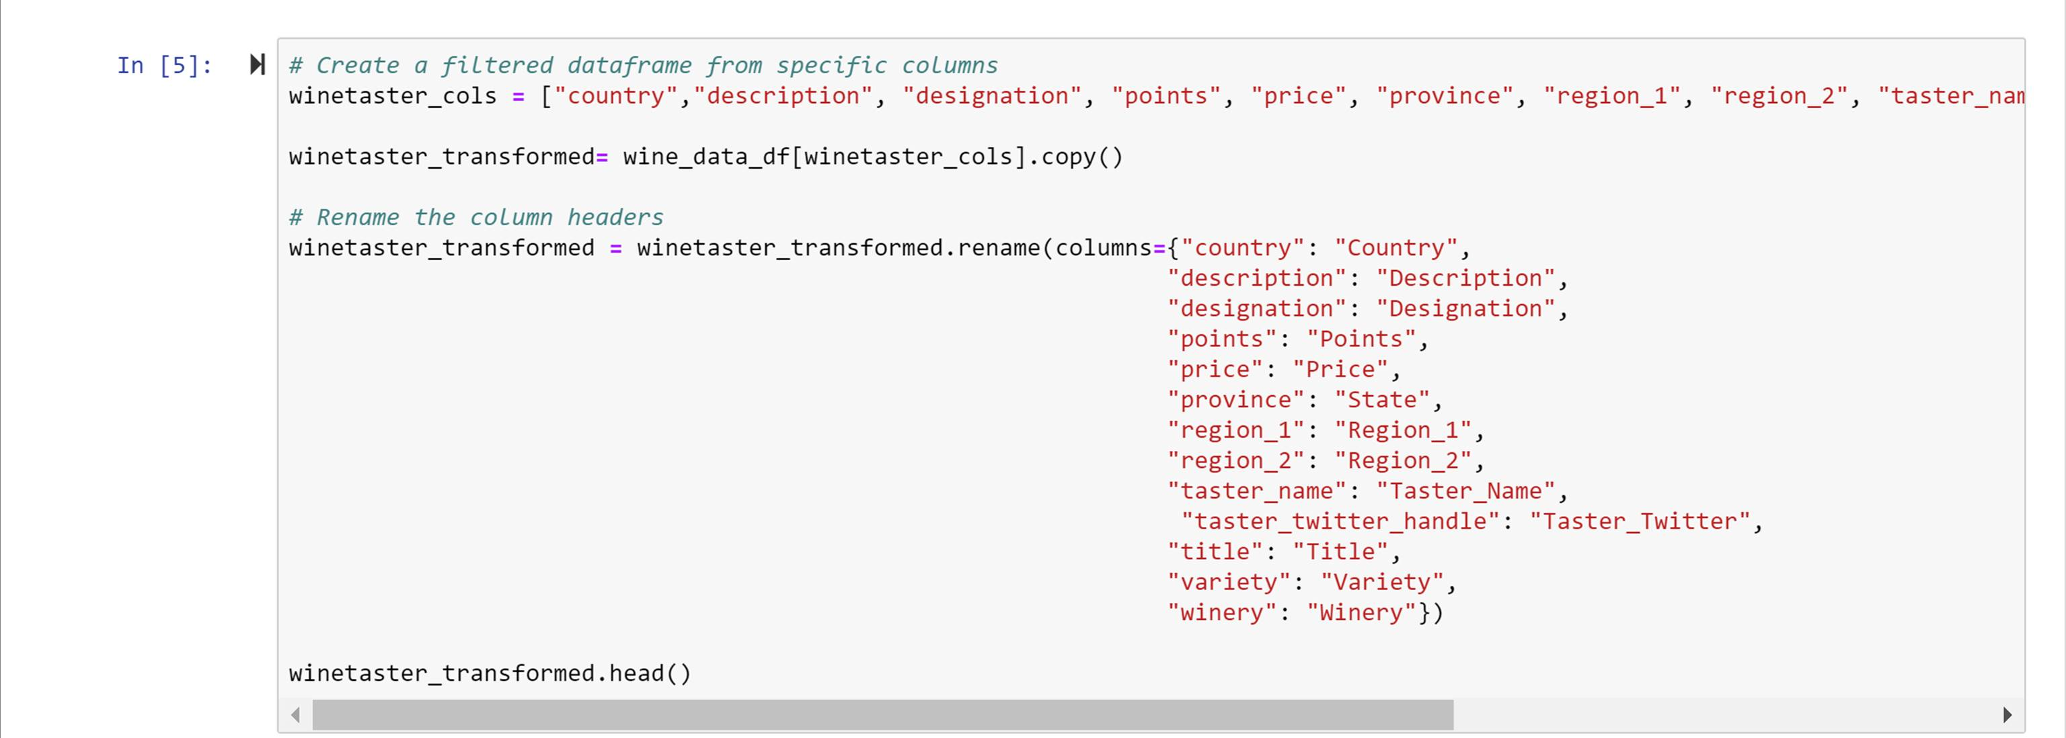
Dependencies
Store XLSX
Clean DataFrame
Store JSON
Clean DataFrame

Slide 3


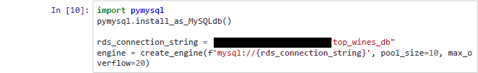
Clean DataFrame
Clean DataFrame
Clean DataFrame
Clean DataFrame
Clean DataFrame
Clean DataFrame
Connect to Local Database
Check for Tables

Slide 4
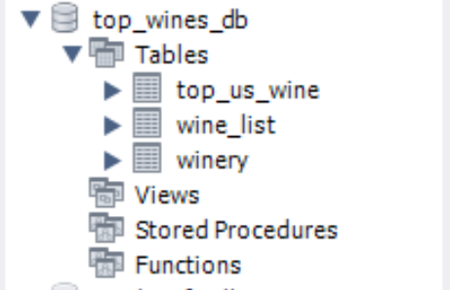
Load converted DataFrame into Database using Pandas

Slide 5
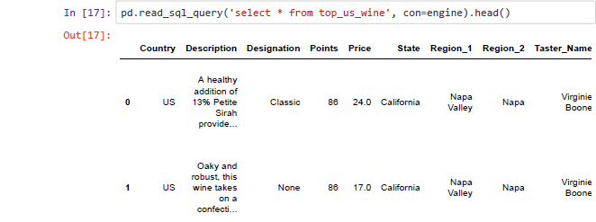
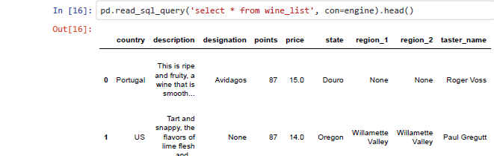
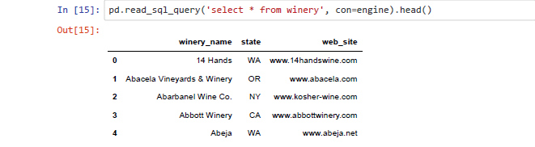
Confirm data has been added by querying the tables

Slide 6
